Slide 1
6~7. Defining Classes and Methods
[ECE20016/ITP20003] Java Programming
Notes:
‹#›

Slide 2
Agenda
Class and Method Definitions
Information Hiding and Encapsulation
Objects and References

Slide 3
Class and Method Definitions
Java program consists of objects
Objects of class types
Objects that interact with one another
Program objects can represent
Objects in real world
Abstractions

Slide 4
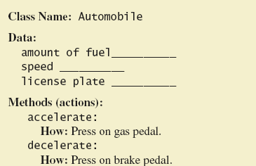
Class and Method Definitions
Ex) A class as a blueprint

Slide 5
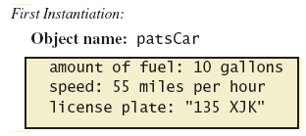
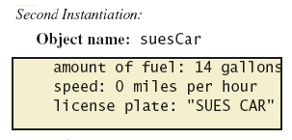
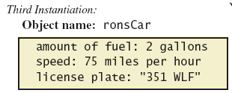
Class and Method Definitions
Objects (instances) that are instantiations of the class Automobile

Slide 6
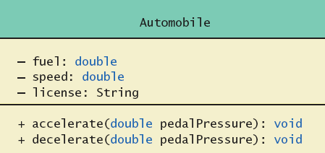
Class and Method Definitions
A class outline as a UML class diagram
cf. UML: Unified Modeling Language

Slide 7
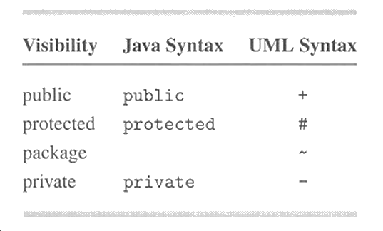
UML Visibility

Slide 8
Class Files and Separate Compilation
Each Java class definition usually in a file
The filename should be ClassName.java
Class can be compiled separately
Helpful to keep all class files used by a program in the same directory

Slide 9
Dog class and Instance Variables
public class Dog
{
public String name;
public String breed;
public int age;
public void writeOutput()
{
System.out.println("Name: " + name);
System.out.println("Breed: " + breed);
System.out.println("Age in calendar years: " + age);
System.out.println("Age in human years: " + getAgeInHumanYears());
System.out.println();
}
public int getAgeInHumanYears()
{
int humanYears = 0;
if (age <= 2) {
humanYears = age * 11;
} else {
humanYears = 22 + ((age-2) * 5);
}
return humanYears;
}
}

Slide 10
Dog class and Instance Variables
The Dog class has
Three pieces of data (instance variables)
Two behaviors (methods)
Each instance of this type has its own copies of the data items.
Use of public
No restrictions on how variables used
Can be replaced with private
Notes:
‹#›

Slide 11
Java Access Modifiers
 | public | protected | default | private
same class | O | O | O | O
same package | O | O | O
derived classes | O | O
other | O

Slide 12
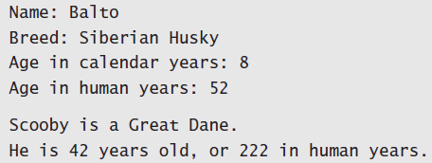
DogDemo
public class DogDemo
{
public static void main(String[] args)
{
Dog balto = new Dog();
balto.name = "Balto";
balto.age = 8;
balto.breed = "Siberian Husky";
balto.writeOutput();
Dog scooby = new Dog();
scooby.name = "Scooby";
scooby.age = 42;
scooby.breed = "Great Dane";
System.out.println(scooby.name + " is a " + scooby.breed + ".");
System.out.print("He is " + scooby.age + " years old, or ");
int humanYears = scooby.getAgeInHumanYears();
System.out.println(humanYears + " in human years.");
}
}

Slide 13
Methods
When you use a method you "invoke" or "call" it
Two kinds of Java methods
Return a single item
Use anywhere a value can be used
Perform some other action – a void method
Resulting statement performs the action defined by the method
The method main
public static void main(String[] args)
A void method
Invoked by the system

Slide 14
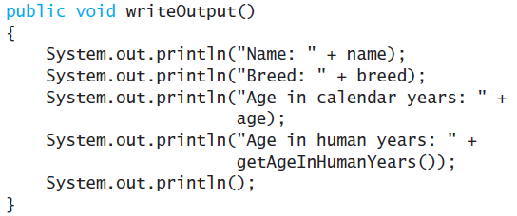
Defining Methods
Method definitions appear inside class definition
Can be used only with objects of that class

Slide 15
Defining Methods
Most method definitions we will see as public
Void method does not return a value
Head
Method name + parameters
Body
Enclosed in braces { }
Think of method as defining an action to be taken

Slide 16
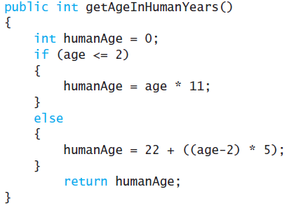
Methods That Return a Value
Heading declares type of value to be returned
Last statement executed is return

Slide 17
The Keyword this
Referring to instance variables outside the class
Syntax) ObjectName.VariableName
Referring to instance variables inside the class
Use VariableName alone
The object (unnamed) is understood to be there.
Inside the class the unnamed object can be referred to with the name this
Ex) this.name = keyboard.nextLine();
The keyword this stands for the receiving object

Slide 18
Class and Object
Class definition
Similar to drawing a blueprint.
public class Automobile{
private double fuel;
private double speed;
private String license;
public void accelerate(…) {
...
}
public void deaccelerate(…) {
...
}
…
}
Object creation
Similar to making a product.
Automobile suesCar = new Automobile();
/*
statements to set attributes of suesCar
*/
In suesCar.accelerate(…),
fuel means suesCar.fuel
speed means suesCar.speed
this means suesCar
suesCar
-fuel = 14
-speed = 0
-license = “SUES CAR”
+accelerate(…): void
+deaccelerate(…): void

Slide 19
Local Variables
Variables declared inside a method are called local variables
May be used only inside the method
All variables declared in method main are local to main
Local variables having the same name and declared in different methods are different variables

Slide 20
BankAccount
public class BankAccount
{
public double amount;
public double rate;
public void showNewBalance ()
{
double newAmount = amount + (rate / 100.0) * amount;
System.out.println ("With interest added, the new amount is $“
+ newAmount);
}
}

Slide 21

LocalVariablesDemoProgram
public class LocalVariablesDemoProgram
{
public static void main (String [] args)
{
BankAccount myAccount = new BankAccount ();
myAccount.amount = 100.00;
myAccount.rate = 5;
double newAmount = 800.00;
myAccount.showNewBalance ();
System.out.println ("I wish my new amount were $“
+ newAmount);
}
}

Slide 22
Blocks
Blocks or compound statements
Statements enclosed in braces { }
When you declare a variable within a compound statement
The scope of the variable is from its declaration to the end of the block
Variable declared outside the block usable both outside and inside the block

Slide 23
Parameters of Primitive Type
class SpeciesSecondTry {
…
public int predictPopulation (int years)
{
int result = 0;
double populationAmount = population;
int count = years;
while ((count > 0) && (populationAmount > 0))
{
populationAmount = (populationAmount +
(growthRate / 100) * populationAmount);
count - - ;
}
if (populationAmount > 0)
result = (int) populationAmount;
return result;
}
}

Slide 24
Parameters of Primitive Type
Declaration
public int predictPopulation(int years)
The formal parameter is years
Calling the method
int futurePopulation = speciesOfTheMonth.predictPopulation(10);
The actual parameter is the integer 10

Slide 25
Parameters of Primitive Type
Parameter names are local to the method
When method invoked
Each parameter initialized to value in corresponding actual parameter
Primitive actual parameter cannot be altered by invocation of the method
Automatic type conversion performed byte -> short -> int -> long -> float -> double

Slide 26
Agenda
Class and Method Definitions
Information Hiding and Encapsulation
Objects and References

Slide 27
Information Hiding
Programmer using a class method need NOT know details of implementation
Only needs to know what the method does
Information hiding
Designing a method so it can be used without knowing details
Also referred to as abstraction
Method design should separate what from how

Slide 28
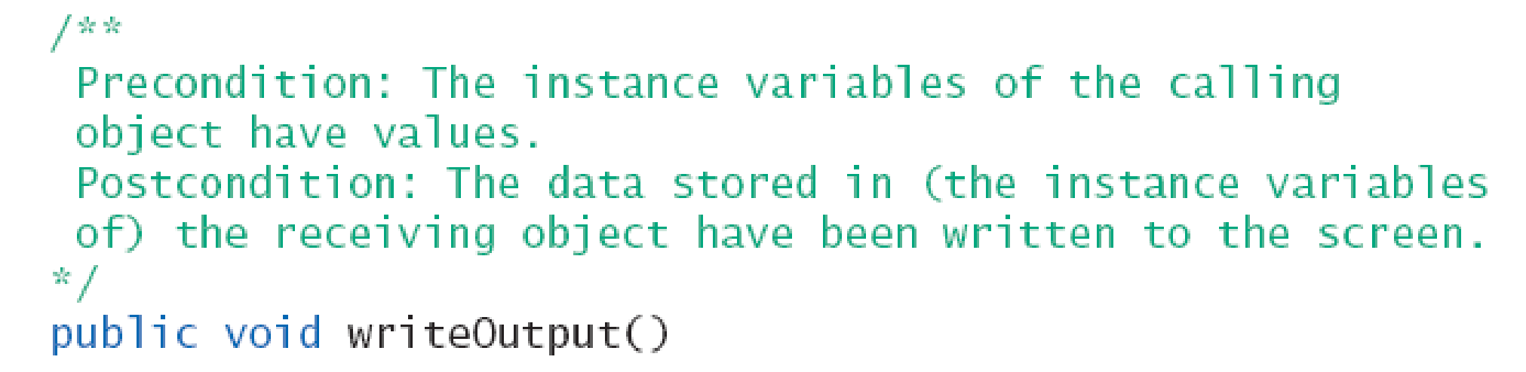
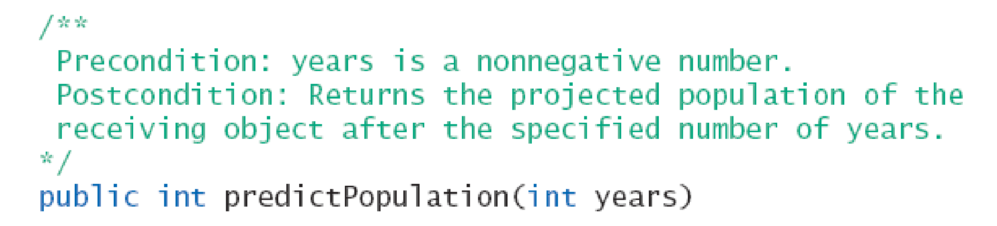
Pre- and Postcondition Comments
Precondition comment
States conditions that must be true before method is invoked
Postcondition comment
Tells what will be true after method executed

Slide 29
The public and private Modifiers
Type specified as public
Any other class can directly access that object by name
Classes generally specified as public
Instance variables usually not public
Instead specify as private

Slide 30
Programming Example
public class Rectangle
{
private int width;
private int height;
private int area;
public void setDimensions (int newWidth, int newHeight)
{
width = newWidth;
height = newHeight;
area = width * height;
}
public int getArea ()
{
return area;
}
}
➔ Statement such as “box.width = 6;” is illegal.

Slide 31
Programming Example
public class Rectangle2
{
private int width;
private int height;
public void setDimensions (int newWidth, int newHeight)
{
width = newWidth;
height = newHeight;
}
public int getArea ()
{
return width * height;
}
}
setDimensions() method is the only way the width and height may be altered outside the class.

Slide 32
Accessor and Mutator Methods
When instance variables are private must provide methods to access values stored there
Typically named getSomeValue()
Referred to as an accessor method
Must also provide methods to change the values of the private instance variable
Typically named setSomeValue()
Referred to as a mutator method

Slide 33
Accessor and Mutator Methods
Consider an example class (Projector) with accessor and mutator methods
Note the mutator method
setTemperature(int temperature)
Note accessor methods
getTemperature(), getDescription();

Slide 34
Methods Calling Methods
A method body may call any other method
If the invoked method is within the same class, object name can be omitted.
In Projector class
public void turnOn() { System.out.println("My project is turing on!"); getLampTemparature(); } private void getLampTemparature() { System.out.println("My projector temparature is :" + mLampTemparature); }

Slide 35
Encapsulation
Consider example of driving a car
We see and use brake pedal, accelerator pedal, steering wheel – know what they do
We do not see mechanical details of how they do their jobs
Encapsulation divides class definition into
Class interface
Class implementation

Slide 36
Encapsulation
A class interface
Tells what the class does
Gives headings for public methods and comments about them
A class implementation
Contains private variables
Includes definitions of public and private methods

Slide 37
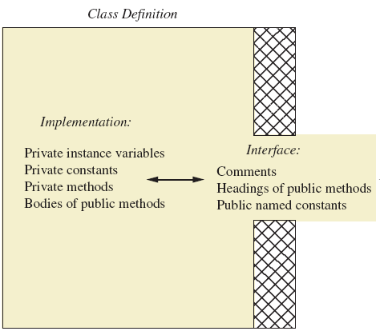
Encapsulation
A well encapsulated class definition
Programmer who uses the class

Slide 38
Encapsulation
Preface class definition with comment on how to use class
Declare all instance variables in the class as private.
Provide public accessor methods to retrieve data
Provide public methods manipulating data
Such methods could include public mutator methods.
Place a comment before each public method heading that fully specifies how to use method.
Make any helping methods private.
Write comments within class definition to describe implementation details.

Slide 39
Automatic Documentation javadoc
Generates documentation for class interface
Comments in source code must be enclosed in /** */
Utility javadoc will include
These comments
Headings of public methods
Output of javadoc is HTML format

Slide 40
UML Class Diagrams
A class outline as a UML class diagram

Slide 41
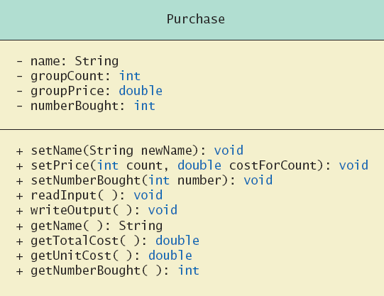
UML Class Diagrams
The Purchase class
Minus signs imply private access
Plus signs imply public access

Slide 42
UML Class Diagrams
Contains more than interface, less than full implementation
Usually written before class is defined
Used by the programmer defining the class
Contrast with the interface used by programmer who uses the class

Slide 43
Agenda
Class and Method Definitions
Information Hiding and Encapsulation
Objects and References

Slide 44
Variables of a Class Type
All variables are implemented as a memory location
Variable of primitive type contains data in the memory location assigned to the variable
Ex) int i;
Variable of class type contains memory address of object named by the variable
Ex) MyClass obj = new MyClass();

Slide 45
Variables of a Class Type
Object itself not stored in the variable
Stored elsewhere in memory
Variable contains address of where it is stored
Address is called the reference to the variable
A reference type variable holds references (memory addresses)
This makes memory management of class types more efficient

Slide 46
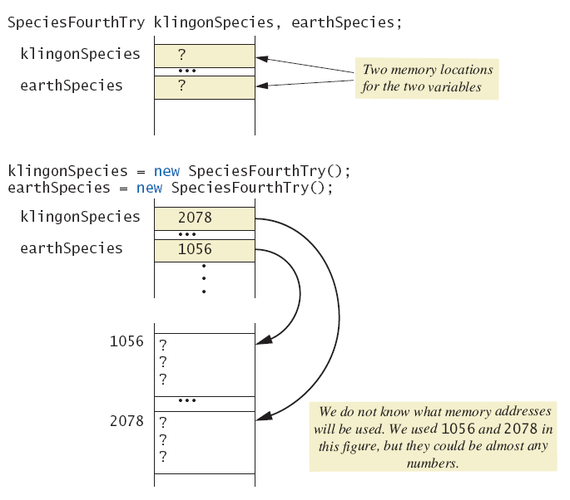
Variables of a Class Type
Behavior of class variables

Slide 47
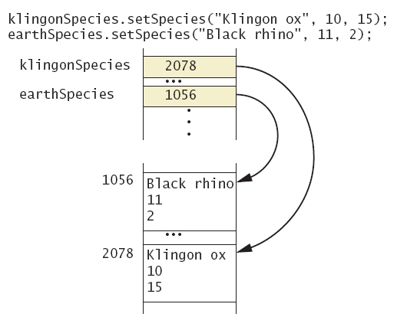
Variables of a Class Type
Behavior of class variables

Slide 48
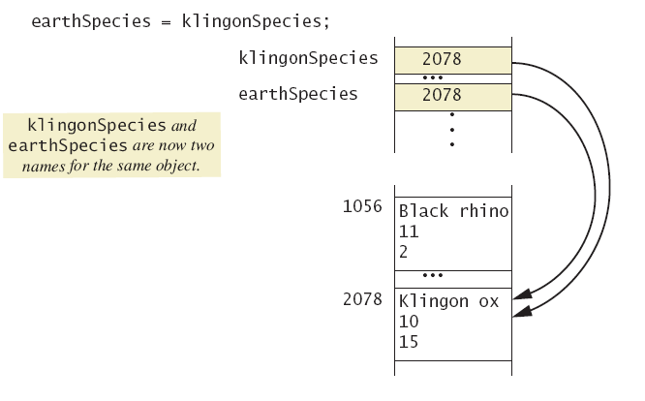
Variables of a Class Type
Behavior of class variables

Slide 49
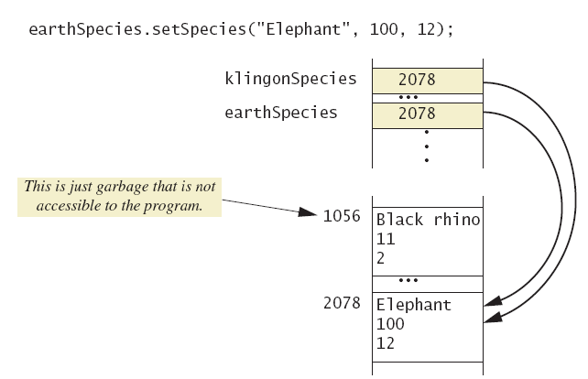
Variables of a Class Type
Behavior of class variables

Slide 50
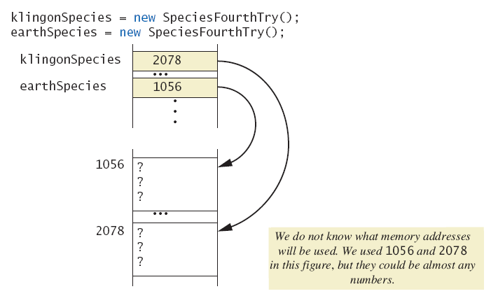
Variables of a Class Type
Dangers of using == with objects

Slide 51
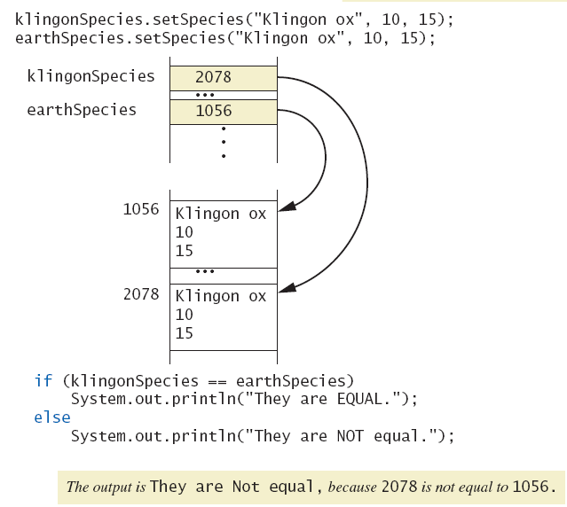
Variables of a Class Type
Dangers of using == with objects

Slide 52
Defining an equals Method
We CANNOT use == to compare two objects
We must write a method for a given class which will make the comparison as needed
import java.util.Scanner;
public class Species
{
private String name;
private int population;
private double growthRate;
…
public boolean equals (Species otherObject)
{
return (this.name.equalsIgnoreCase (otherObject.name)) &&
(this.population == otherObject.population) &&
(this.growthRate == otherObject.growthRate);
}
}

Slide 53
Demonstrating an equals Method
public class SpeciesEqualsDemo
{
public static void main (String [] args)
{
Species s1 = new Species (), s2 = new Species ();
s1.setSpecies ("Klingon ox", 10, 15);
s2.setSpecies ("Klingon ox", 10, 15);
if (s1 == s2)
System.out.println ("Match with ==.");
else
System.out.println ("Do Not match with ==.");
if (s1.equals (s2))
System.out.println ("Match with the method equals.");
else
System.out.println ("Do Not match with the method equals.");
System.out.println ("Now we change one Klingon ox to all lowercase.");
s2.setSpecies ("klingon ox", 10, 15); //Use lowercase
if (s1.equals (s2))
System.out.println ("Match with the method equals.");
else
System.out.println ("Do Not match with the method equals.");
}
}

Slide 54
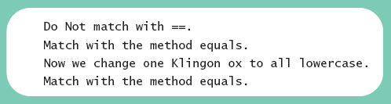
Demonstrating an equals Method
Result

Slide 55
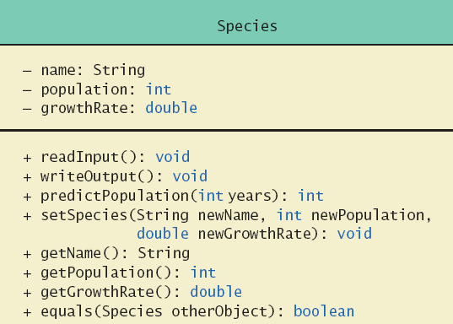
Can you code Species class?
Class Diagram for the class Species

Slide 56
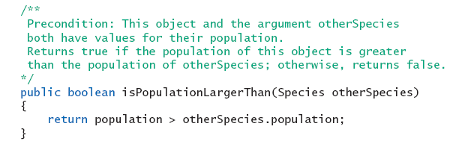
Boolean-Valued Methods
Methods can return a value of type boolean
Use a boolean value in the return statement

Slide 57
Parameters of a Class Type
When assignment operator used with objects of class type
Only memory address is copied
Similar to use of parameter of class type
Memory address of actual parameter passed to formal parameter
Formal parameter may access public elements of the class
Actual parameter thus can be changed by class methods

Slide 58
DemoSpecias
Tries to set intVariable equal to the population of this object. But arguments of a primitive type cannot be changed.
public void tryToChange (int intVariable)
{
intVariable = this.population;
}
Tries to make otherObject reference this object. But arguments of a class type cannot be replaced.
public void tryToReplace (DemoSpecies otherObject)
{
otherObject = this;
}
Changes the data in otherObject to the data in this object.
public void change (DemoSpecies otherObject)
{
otherObject.name = this.name;
otherObject.population = this.population;
otherObject.growthRate = this.growthRate;
}

Slide 59
ParametersDemo
public class ParametersDemo
{
public static void main (String [] args)
{
DemoSpecies s1 = new DemoSpecies (), s2 = new DemoSpecies ();
s1.setSpecies ("Klingon ox", 10, 15);
int aPopulation = 42;
System.out.println ("aPopulation BEFORE calling tryToChange: “ + aPopulation);
s1.tryToChange (aPopulation);
System.out.println ("aPopulation AFTER calling tryToChange: “ + aPopulation);
s2.setSpecies ("Ferengie Fur Ball", 90, 56);
System.out.println ("s2 BEFORE calling tryToReplace: ");
s2.writeOutput ();
s1.tryToReplace (s2);
System.out.println ("s2 AFTER calling tryToReplace: ");
s2.writeOutput ();
s1.change (s2);
System.out.println ("s2 AFTER calling change: ");
s2.writeOutput ();
}
}

Slide 60
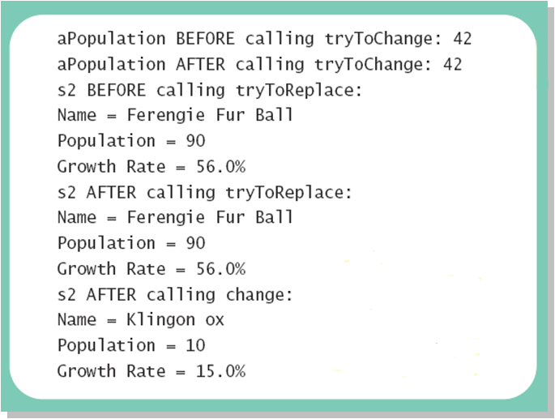
Programming Example

